Slide 1
A Programmer: saves
Python Programming

Slide 2
File Writing
with open('log.txt', 'a') as log:
num_chars = log.write("Hello\n")

Slide 3
File Reading
with open('log.txt', 'r') as log:
for line in log:
print(line, end='')

Slide 4
File Modes
'r' open existing file for read (default)
'w' open file for write, create or overwrite existing file
'a' open file for append, create if does not exist
'x' create file and open for write, fails if file exists (3.3)
'r+' open existing file for read/write
'w+' create & truncate file for read/write
'a+' create & append file for read/write

Slide 5
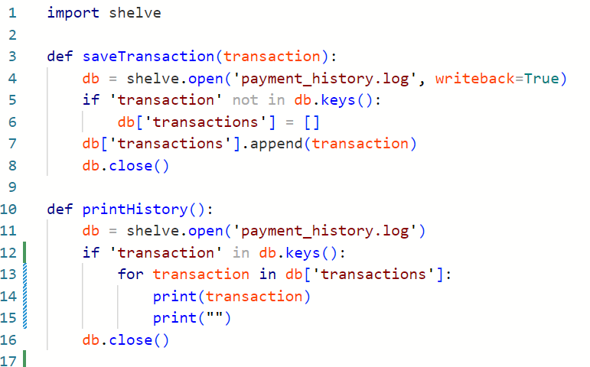
Save Objects

